Slide 1

Automated Irrigation system Applied in Crop Farming
(ITC’s Green House)
Lecturer : HEL CHANTHAN
Student : PROEUNG BUNRONG (e20191346)
Department : I3 GTR

Slide 2
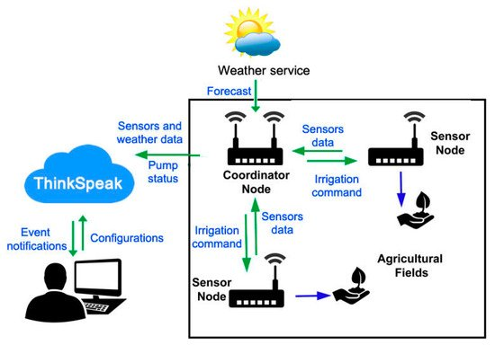
Project analysis slide 4
Project Analysis
The Composition of the system
The system is composed mainly of three parts:
Cloud Platform, Coordinator Node, and Sensor Nodes …

Slide 3
Project analysis slide 10
Project Analysis
Planning for first month
Week 1 6 Aug – 13 Aug | Week2 14 Aug – 20 Aug | Week3 21 Aug – 27 Aug | Week4 28 Aug – 3 Sep
Researching Code and test with dht11 Create charnel Thingspeak and testing. | To understand problem of code, Using Wi-Fi with username Combine code with coordinator and testing then send data to Thingspeak. | Collect data from Greenhouse send to Thingspeak And show all the result of Temperature (T1+T2) Or another Sensor on thingspeak. | Need to Complete planning of first month and continue working for second month to use Camera in greenhouse.
Missing: testing some error, problem to understand something in code | Not ready combine code with coordinator yet.

Slide 4
Project analysis slide 7
Project Analysis
Outline
- Results testing ESP8266 with coordinator
- Testing Send Data From Arduino to NodeMCU
- Code for Send Data From Arduino to NodeMCU
- Testing NodeMCU send data to thingspeak.

Slide 5
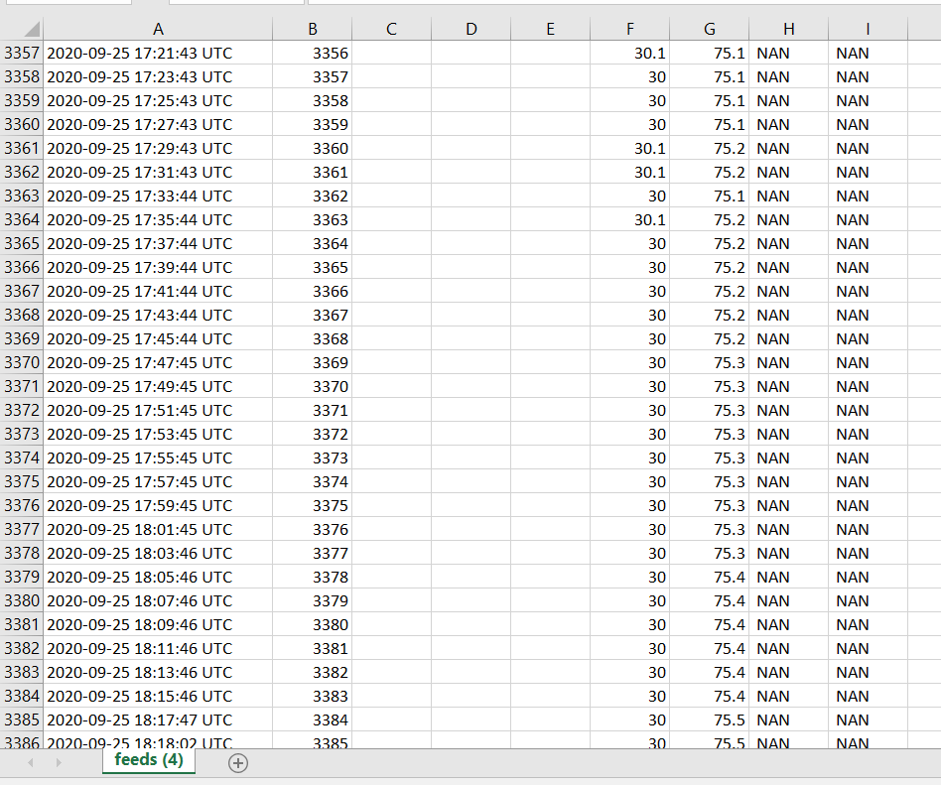
Project analysis slide 7
Project Analysis
Results Testing ESP8266 with Coordinator
Testing collect data from node2 and send to thingspeak by delay 2mn.

Slide 6
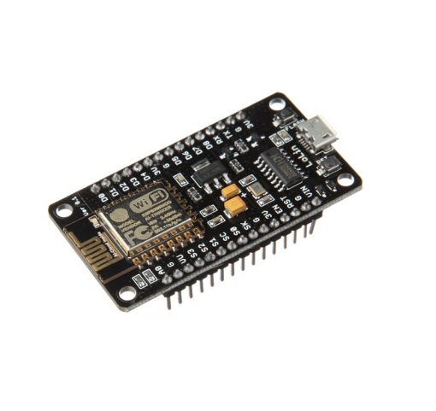
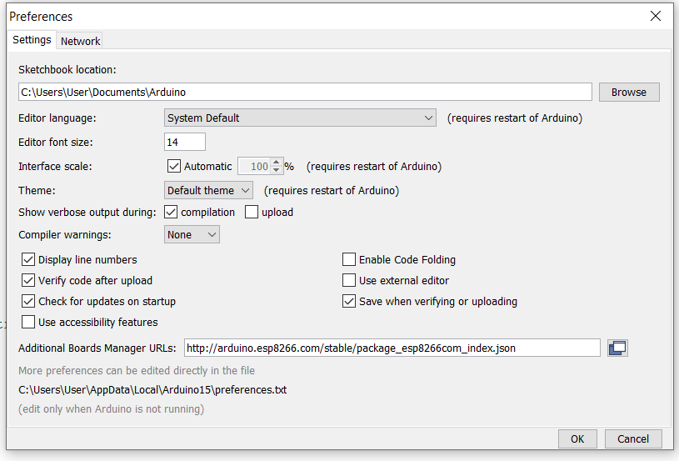
Project analysis slide 10
Project Analysis
Testing Send Data From Arduino to NodeMCU
Setting Up ESP8266 for Arduino IDE
Need to install ESP8266 add on in Arduino IDE, for this go to TOOLS > Preferences.
http://arduino.esp8266.com/package_esp8266com_index.json paste this link to “Additional Board Manager URLs”

Slide 7
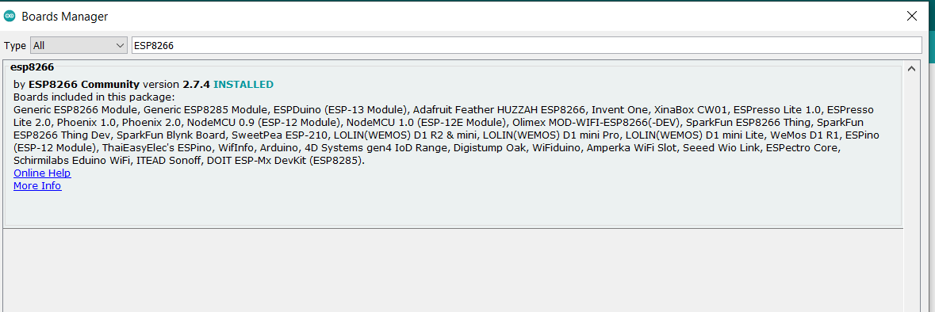
Project analysis slide 3
Project Analysis
Install boards manager
Go to Tools > Board > Boards Manager
Type “ESP8266” in search bar, You will see ESP8266 by ESP8266 community. Click on Install. I have already installed it. you can see it is showing “INSTALLED”.

Slide 8
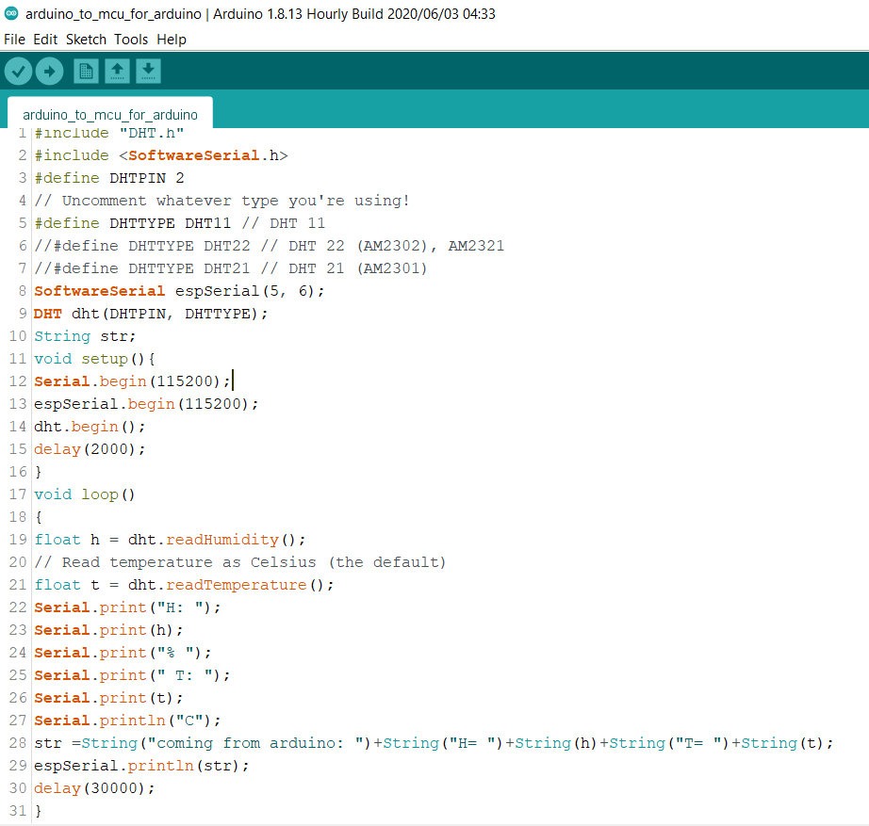
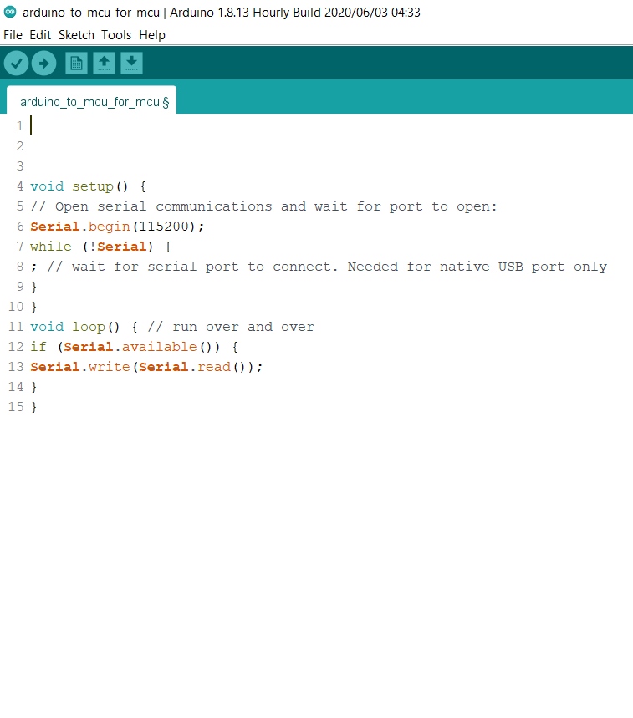
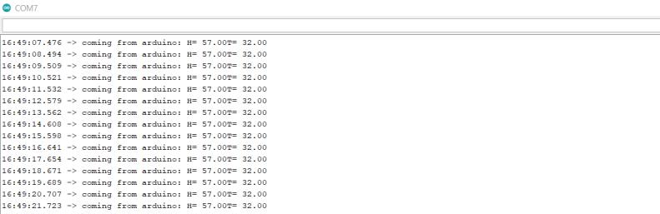
Project analysis slide 7
Project Analysis
Code for Send Data From Arduino to NodeMCU

Slide 9
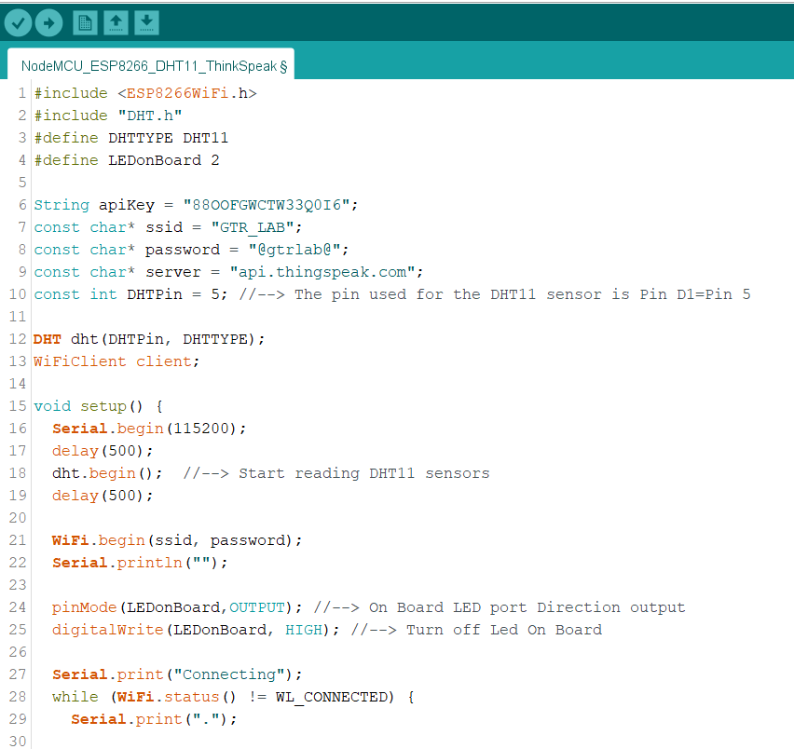
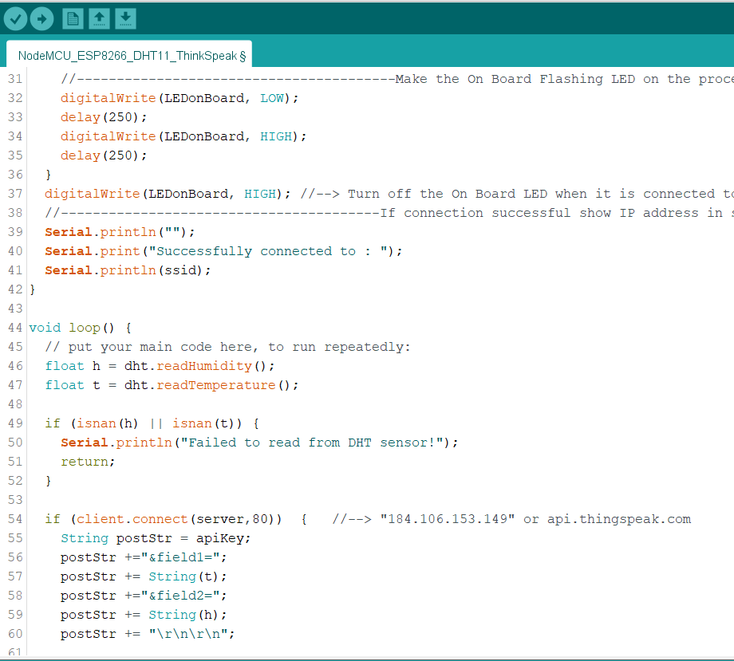
Project analysis slide 7
Project Analysis
Testing NodeMCU send data to thingspeak.

Slide 10
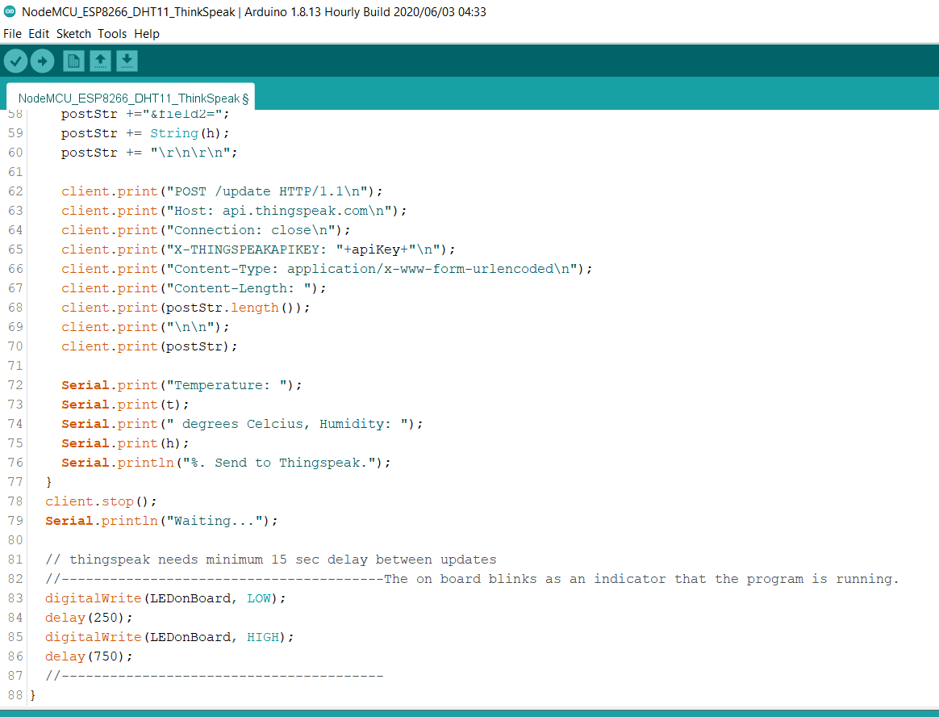
Project analysis slide 7
Project Analysis

Slide 11
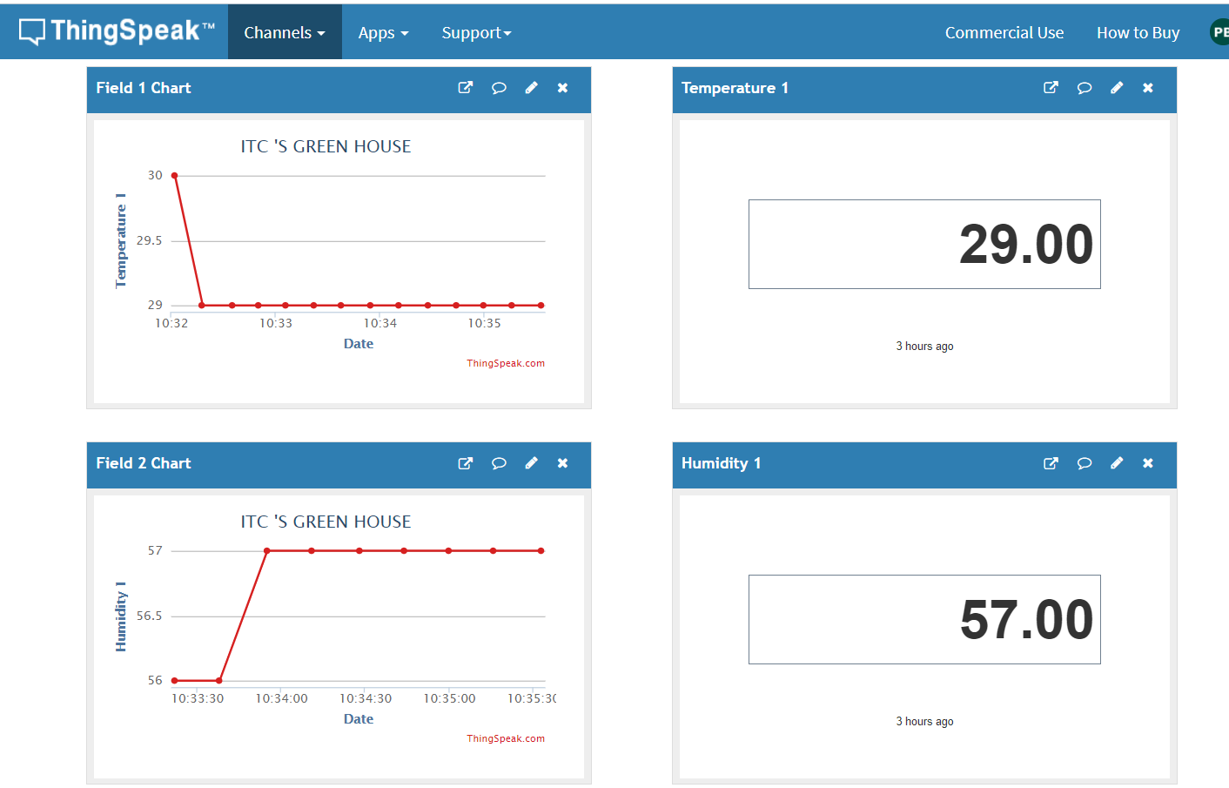
Project analysis slide 7
Project Analysis
Testing NodeMCU send data Temperature and Humidity to thingspeak

Slide 12
Thank You

